Slide 1
Assessment and Management of Psychosocial issues in Advanced Diseases (60 minutes)

Slide 2
Name a few Psychological and Social issues related to advanced diseases
Post your responses in the Chat box

Slide 3
Psychological, Social and Psychosocial
Psychosocial is derived from a combination of the terms psychological and social.
Psychological means in our mind, our inner world.
Social means our interactions with the external world/people- friends, family, social networks, our life as a social being.
Psychological and social always influence each other and cannot be isolated from each other, hence the term psychosocial.
Psychosocial aspects of illness are important in treatment and care. Without understanding and supporting this component, care may be incomplete and sometimes ineffective.

Slide 4
Name some of the barriers we as health care teams have in addressing psychosocial issues along with clinical care that we offer
Post your responses in the Chat box ( 5 minutes)

Slide 5
Barriers to Psychosocial care
Patient factors
Patients may feel that talking about psychological factors will make them seem ‘crazy’
Patients may be embarrassed to discuss Psychological or social issues.
Professional factors
Feeling ill-equipped to deal with psychosocial issues
Lack of training
Misconceptions such as ‘it takes too much time’/ ‘I won’t be able to deal with it’ / that ‘it is just talking, not really doing anything’….
Not familiar with tools for assessment

Slide 6
Assessing social issues
Identity & Role
What are the leading roles or social identity of the patient
Eg related to their job/study, role in the family (breadwinner, homemaker, dependent e.tc) or position in society
How has illness affected these?
Functioning
Activities of daily living and social interactions,
How has illness affected this?
Relationships
Family, Friends, and Neighbours
the quality of these relationships,
whether they are a source of stress or support..
Which are the most trusted relationships?
How has illness affected the relationships?

Slide 7
Psychological Assessment
Should cover five domains
Consciousness and communication
Behavior
Mood/Feelings/Emotions
Thoughts
Insight and perception about the illness

Slide 8
Consciousness and communication
Assessing the cognitive and sensorimotor ability
Is the patient conscious and able to communicate?
Critical factor in assessing psychological issues
If impaired, it can make assessment more challenging.

Slide 9
Behavior
Observation of the patient’s behaviour may give some clues to their thinking and feelings.
Such observations should be discussed with the patient to check their accuracy.
Any abnormal behavior should be always be cross-checked with the patient (e.g., if a patient is talking to themselves, you can comment on this and ask what the patient is talking to themselves about and why)

Slide 10
Mood/Feelings/Emotions
These may be expressed through behavior and gestures
Our assessment needs to be compared with what the patient says about their emotions.
Common emotions include sadness, anger, happiness, anxiety/fear

Slide 11
Thoughts
What is the internal conversation that the patient is having in his/ her own mind?
Impossible to know without asking the patient.

Slide 12
Insight and perception about illness
Does the patient believe he/ she is ill?
Does he/ she know what are the main facts about the illness?
What are his/ her views about the disease and prognosis?
What are his/ her views about the impact of the illness on his/ her life, including emotional status?

Slide 13
Activity (5 minutes – your response in the Chatbox)
The following are about a 40-year-old woman with advanced cervical cancer. #Which of them do you consider Normal? #Which of them do you think is Abnormal? #Which of them are you Not Sure?
Always appears to be sad, and weeps/cries when she is alone
Does show any reaction when her 4-year-old grandson shows a drawing he made for the grandmother
Does not have an appetite
Tries to consume Five days’ supply of morphine medicines at once
Try to tear her clothes off, shout and spit at the carer
Laughs and says she will not die because he is God

Slide 14
Response to illness
Normal response
Significant response/ suspected abnormality

Slide 15
Normal distress
Sadness, Anger, Worrying, fear, uncertainty
Preoccupation with death/illness/social stressors
Poor concentration, Poor sleep and appetite

Slide 16
How to help with normal distress
Clarify diagnosis/prognosis
Develop trust
Mobilise available resources
internal (memories of previous experience of hardship, faith, prayer)
external (friends, family, support services, neighbours etc)
Practical support (finances, food, shelter, clothes, medicines, transport etc)
Supportive therapy (effective listening, empathy, reflection, ventilation)
Symptom management

Slide 17
Significant distress or suspected abnormality
Psychiatric disorders such as depression, anxiety, delirium and psychosis.
Possible features indicating a need for referral to a Mental Health Professional:
Emotions/Thoughts/Behavior that may be qualitatively normal but quantitatively abnormal (present to an extreme degree or present all the time in a severe manner) e.g. anxiety and depressive disorders
Emotions/Thoughts/Behavior that interfere with necessary treatment, care and support e.g denial
Emotions/Thoughts/Behavior that are qualitatively abnormal and uncharacteristic for the patient (appear grossly abnormal to family or carers) e.g delirium, psychosis, depression

Slide 18
How to help with significant distress
Support from the Mental Health team: Psychologist/Psychiatric nurse/Psychiatric social worker or Psychiatrist
Social support by trained volunteers, social worker
Spiritual support by respected senior members of the society/ clergy

Slide 19
Distress Thermometer as a tool to rate distress
Self-reported tool using a 0-to-10 rating scale.
Simple tool
Can be administered by anyone familiar with the tool
Takes less than 3 minutes
In addition to the level of distress, the patient is also asked to identify sources of distress using a Problem List.
Consistently high scores will indicate a need for referral to a Mental Health Professional

Slide 20
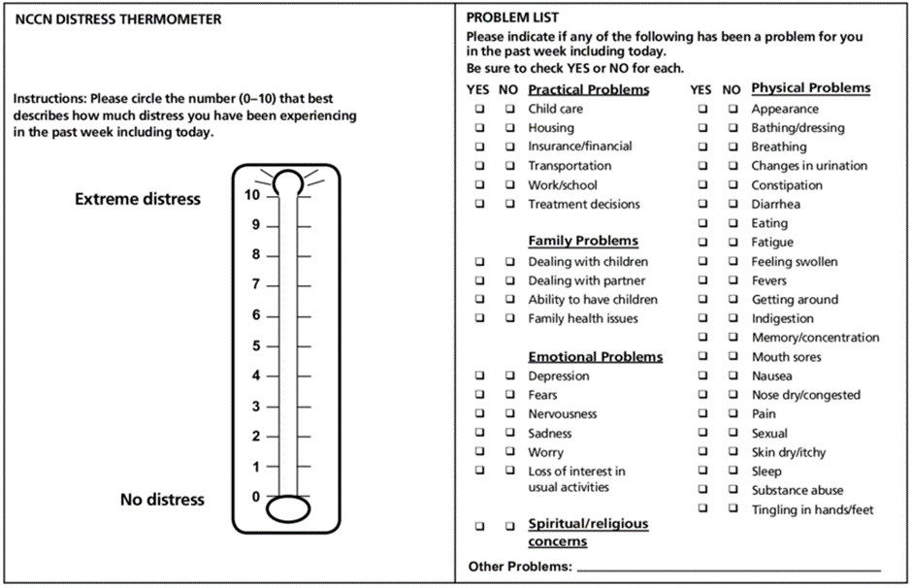
NCCN (National Comprehensive Cancer Network) Distress Thermometer

Slide 21
Assessment of social issues

Slide 22
Social Issues
Broadly under three categories
Survival
Basic comforts of daily living
Relationships

Slide 23
Survival
Shelter
Does the patient have a clean and secure shelter?
Food
Does the patient have a provision to have decent meals every day?
Clothing
Does the patient have provision for decent clean clothing?

Slide 24
Basic Comforts of daily living
Clean water
Electricity
TV/ Radio?
Educational status of the patient and members of the family
Earning members of the family

Slide 25
Relationships
With other family members
With neighbours
With other people in the community
Part of any social/ religious/ political groups? Is that helpful now?
Any change in relationships after getting ill?

Slide 26
Thank you!

